Slide 1

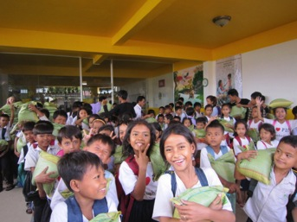
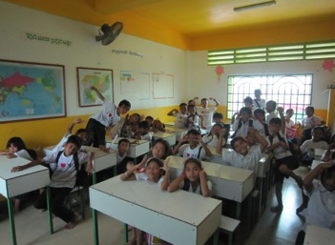
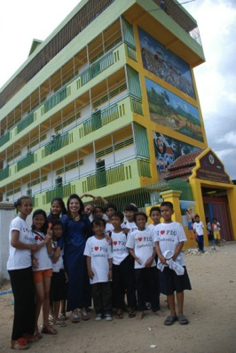
P.I.O.’s Newsletter
Issue 1, July 2012
Phnom Penh, Cambodia
“Nobody wants to work on the garbage dump and sleep on the street. I know PIO is making a difference when I see the poor children happy, enjoying themselves at school, smiling with hope for the future”
Phymean Noun
In this issue…
A message from Phymean Noun, founder and executive director
Personal introduction from Johnny Touch, new project manager
The schools and the students
The shelter and the children
Questions to the teachers
Volunteering for P.I.O.
Thank you letter to donors from Davy Ung, team leader teacher

Slide 2

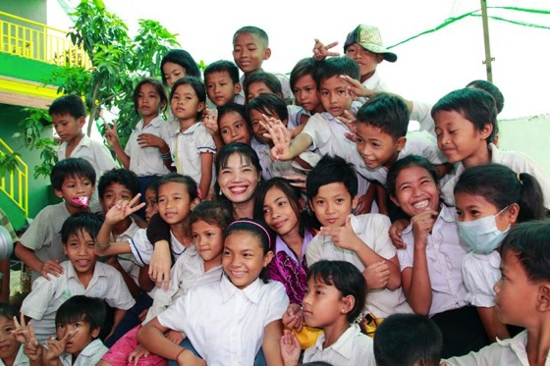
DEAR PIO SUPPORTERS
Every year, generous groups and individuals join me to continue to fulfil my dream of building a better future for some of the most vulnerable and disadvantaged children in Cambodia. As we travel through 2012, I am continually encouraged by the warmth and generosity shown to the students and families living in the communities that PIO works in. Everyone who donates to PIO is working together to improve the lives of the 900 children who attend our schools. From our major donor, Just World International (JWI), and our supporters at Jasmine Charitable Trust and Project Hammer and Richard’s Architectural Lighting and Davidson Family Foundation and Blumenbecker, to the individuals who contribute their time by volunteering in our schools, PIO is forever grateful for the change you are bringing to this part of the world.
We faced a big task in 2012, building two new schools. The new school at Stung Mean Chey is directly across the road from the original school. It is four storeys high and bright yellow, it looks amazing! We also built a beautiful new school building at Borey Santipheap II school, two floors of classrooms and painted green and yellow by volunteers from Singapore and CIS teachers. The top floors of both buildings are large, covered,
open areas perfect for playing and eating lunch in the cool breeze. Both buildings are valued additions to their communities, and will strengthen the lives of the residents for many years to come. Many people worked so hard to fund these important buildings, I can’t thank them enough.
We are very excited to have another busy year planned. Work has begun on a playground for the children at Stung Mean Chey and we are planning the expansion of the orphanage; we are also looking for supporters and donors who can help build the vocational training/ IT computer lab training centre.
Finally, I want to thank everyone who has contributed to strengthening PIO and allowing us to continue the important work that we do. I am so grateful to PIO’s donors and supporters, and I hope you will continue on this journey into the future with us.
Your sincerely,
Phymean Noun

Slide 3
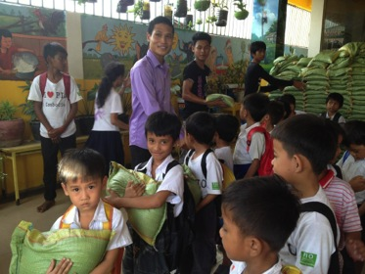
DEAR PIO SUPPORTERS
My first travelling experience from Canada to Cambodia in February of this year had many unexpected surprises. I found myself surrounded by people who I could relate to and understand. Because everywhere I went, everyone spoke a familiar language, Khmer. They cooked the same foods as my mother did and listened to the same music as my father did when I was growing up in Canada. For the reason being that Cambodia was the country that my parents had emigrated from in 1988 and it would be the country in which I now call my new home.
Settling into Cambodia was not so difficult because it was just the right lifestyle change I needed. However, seeing the struggle and the hardships many Cambodian people endured from day to day was discouraging. Fortunately, I was able to change my attitude of hopelessness to action and felt that I could make a difference if I really tried.
Thus a series of events took place that drew me to meet Noun Phymean, the founder of People Improvement Organization. She shared with me her disheartening yet heroic life story and her vision of using education to empower the women and children of Cambodia to foster a better future. I like many people who have been lucky enough to be in her presence, became inspired and I soon found myself working alongside her as PIO’s Project Manager.
The work has been challenging but fulfilling in every way. There is much work to do such as, renovating the old school at Stung Mean Chey into a Vocational Centre, adding another
floor to the Orphanage to accommodate more children and completing the PIO playground.
Overall, I am extremely excited to be a part of PIO’s incredible mission and with this wonderful opportunity, I hope to further support the inspirational changes being made in communities and the many young Cambodian lives.
I would also like to graciously thank Just World International for their compassionate support, and all the hospitable contributions that have been so instrumental in enabling PIO to achieve all that we have. My hope is that we can continue to build a strong cooperative relationship in order to light a brighter future for the children of Cambodia.
Johnny Touch

Slide 4
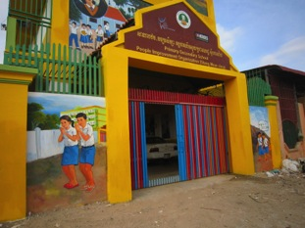
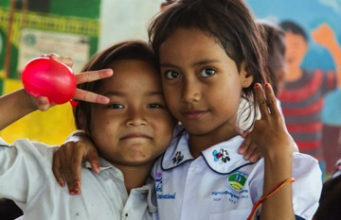
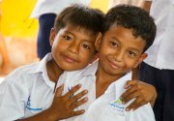
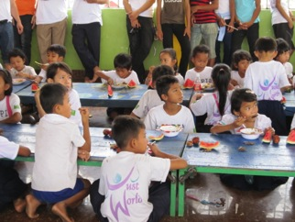
THE STUNG MEAN CHEY SCHOOL
The Stung Mean Chey school provides free education in Khmer and English to 400 underprivileged children with 9 full-time teachers (kindergarten to grade 6).
Students are provided school materials.
Students are served nutritious lunches and purified drinking water everyday.
The children are in charge of keeping their classrooms clean and tidy.
The daily presence of a nurse allows for medical care and first-aid treatment at the school.
Monthly 25kg rice provisions are given to 26 families of enrolled students.
The school playground is about to be completed - we expect it to be fully operational by mid-August

Slide 5
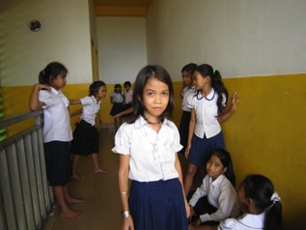
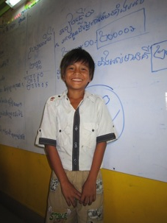
MEET THE STUDENTS…
My name is Srey Meas and I am
11 years old. I am a third grade
student. I live in the Stung Mean Chey
area with my family. I come to school
by bicycle with my older brother who
is a fifth grade student. I started
coming at PIO school three years ago;
before I was going to a local public
school but it very expensive for my parents. I like to study Khmer literature and English. My goal is to learn how to speak well with foreigners who come to PIO. I love the PIO teachers and the volunteers, because they teach us new songs and we can improve our speaking skills. I like coming to school because I have many friends and we play “Jump” during breaks. When I grow up, I want to be a doctor to help all the people in need. Thank you to PIO and all the donors for giving all the school material, the uniform and good food everyday! I will always love you with all my heart!
My name is Ratanak and I am 11 years old.
I am a student in second grade. I love to come
to school! I live with my mother and my 5
siblings in the Preytol neighborhood. I walk to
school every morning, it is a 30 minutes walk.
I have been at the PIO School in Stung
Mean Chey since kindergarten. My favorite
subject is Khmer literature, because there are
many wonderful stories and I like to read.
When I grow up, I want to be a doctor because
I want to take care of my family and all the sick people in Cambodia. I love PIO because I have many friends and we play together and share our problems and thoughts and we always help each other!

Slide 6
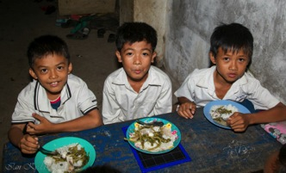
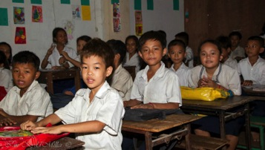
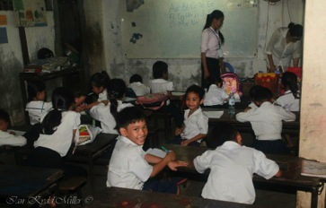
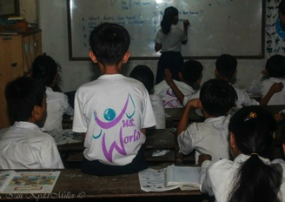
THE BOREY KEILA SCHOOL
The Borey Keila school provides free education in Khmer and English to 350 underprivileged children with 6 full-time teachers (kindergarten to grade 5).
Students are provided school materials, such as notebooks, pens, pencils, crayons, erasers, rulers, drawing paper and school bags.
Students are served nutritious lunches and purified drinking water everyday.
The children are in charge of keeping their classrooms clean and tidy.
The regular visits of a nurse allow for medical care and first-aid treatment at the school.

Slide 7
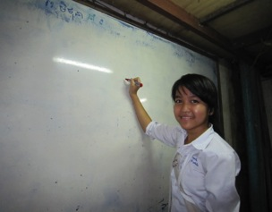
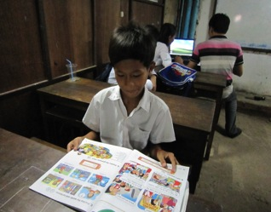
MEET THE STUDENTS…
My name is Pech Sreynech and I am 14
years old. I am a fifth grade student and
I have been at PIO’s school for four years.
I live with my family close to school. I am
the only sibling to go to school. I want to
study because my goal is to become a
doctor. I want to be a surgeon and I want
to help people who are sick.
I believe I can achieve this with PIO’s help and support. PIO is great! It is allowing me to receive an education and to get good food every day. I also like that we sing at school. I have recently participated to the Music Festival for Children organized by the Cambodian Ministry of Information. I love to sing because it makes me feel good.
I want to sing “Thank you PIO” all day long!
My name is Sorsovan Sila and I am 15
years old. I am a fifth grade student at
the Borey Keila school. This is my third
year with PIO and I am so thankful for
all the help and support I am receiving.
I live with my family in building A.
My older brothers work and my sister
who is 12 years old comes to school
with me. My favorite subjects are science and chemistry. I would like to become a pharmaceutical researcher to find new cures and medicines.
I want to be part of PIO for a long time! I like the teachers and all the students. I have many friends at school and we study all together.
In the future, I want to support PIO and give back some of the help I am receiving now because PIO is making me believe in my dreams and allowing me to receive a good education!

Slide 8
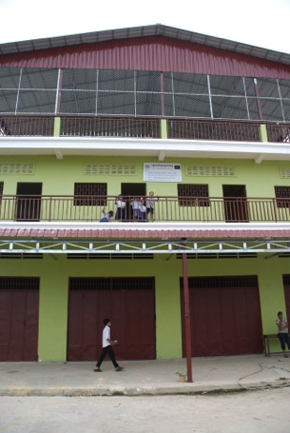
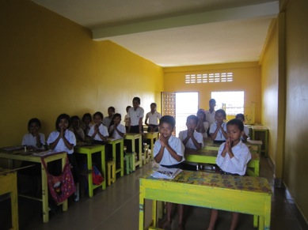
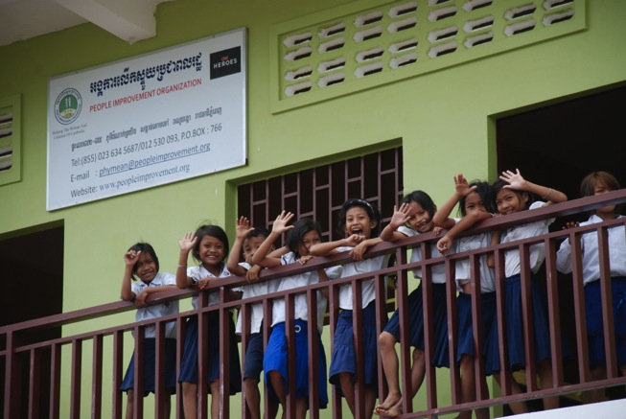
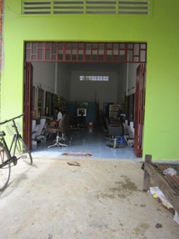
THE BOREY SANTIPHEAP II SCHOOL
The Borey Santipheap II school provides free education in Khmer and English to 201 underprivileged children with 5 full-time teachers (kindergarten to grade 4).
Students are provided school materials.
Since April, the school has two floors and larger classrooms to admit more students.
The students are currently receiving only snacks – we hope to receive more funds to start a complete feeding program.
The beauty salon is being established with the help of a former PIO trainee, Somaly (read her story on page 13) – it is scheduled to be operational in August

Slide 9
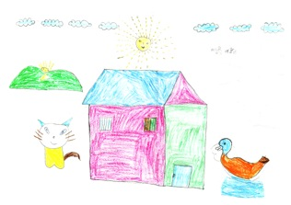
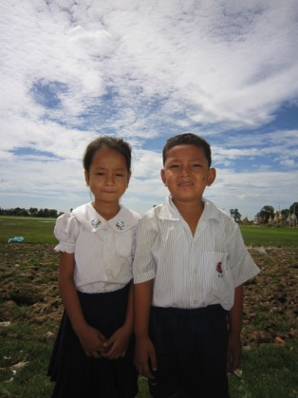
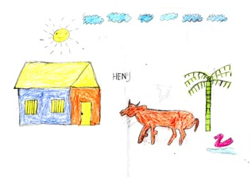
MEET THE STUDENTS…
My name is Vanchan Leakina and I am 6 years old. In my family, there are 10 members. I live in the Borey Santipheap II village with my parents, two sisters and three brothers. My older brothers live and work in Phnom Penh. I am a kindergarten student and this is my second year of school. I like to study English and drawing. I want to be a doctor for children when I grow up to help all the sick children. I love PIO because at school I can study, play and be happy everyday!
Leakina and Song
My name is Song Kamsang and I am 7 years old. I live with my parents, three sisters and one brother. This is my first year of school. I like to read and write in Khmer. I love PIO because I want to have an education and at school I can play with my friends. My favorite game is football! I want to become a doctor to help all the poor and sick people in Cambodia.

Slide 10
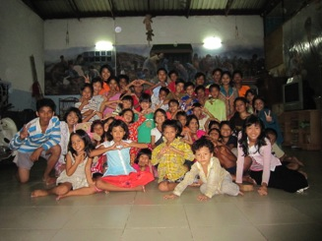
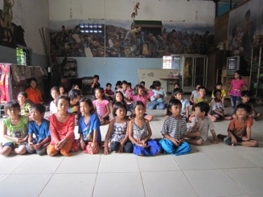
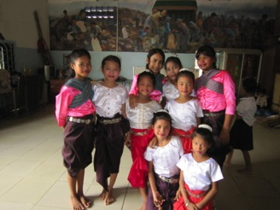
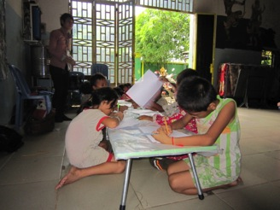
THE ORPHANAGE
With an additional 3 new orphans, there are now a total of 65 children that are being cared for at the orphanage (30 girls and 35 boys).
There are 2 new sponsors who are supporting the children of the orphanage, thus there are total of 39 children under the sponsorship program.
PIO is working on applying for a grant to sponsor some of the children to a music school and learn a Khmer Instrument. We believe this will help build self-esteem and promote creativity.
There are also 6 students from Pannasastra University who come to volunteer every Saturday to help the children with homework.

Slide 11
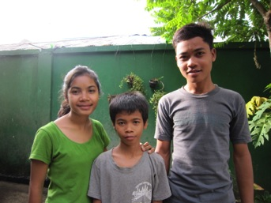
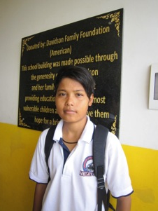
MEET THE CHILDREN…
My name is Srey Mom and I am 13 years old. I live in the shelter with two of my brothers. I have other four older siblings who work and are married. I was born in the Kampong Cham province. In 2008 I came to PIO’s shelter because my father could not afford food for everyone after my mother passed away. I love living here and going to school. Sometimes it’s hard to share the room with other 25 girls, but we are all friends. I also like that I am with my brothers. I am a sixth grade student at the Stung Mean Chey school. I like to study English so that I can speak with the visitors who come. At the shelter, I take traditional dancing classes twice a week. I like the costumes because I look pretty with them. When I grow up, I want to be a tour guide in Phnom Penh to show tourists all the beautiful things in Cambodia. I love PIO because it is offering my brothers and me the opportunity to have a good life!
My name is Veasna. I don’t know my exact age because my original birth certificate was lost. When I first arrived at PIO six years ago, they made me new documents saying I was born in 1990. So I guess I should say I am 21 years old. I was born in the Prey Veng province and I have three sisters and three brothers. When my mother passed away, my father could not take care of us and decided to move to Thailand. My younger sister and me were sent to live with our uncle and aunt in Phnom Penh. We had to work at the garbage dump with them all day long. I wanted to go to school and my aunt heard about PIO school and she brought me to study at PIO. A year later, PIO accepted me to live in the orphanage. I have just successfully ended grade eleven in public school at the Chea Simsamaky High School. Now, I am attending the math program at the Stung Mean Chey school. I like living here because I have many friends and I can improve my self everyday! At PIO, I have learned that living with hope is very important, so you should always smile to your tomorrow!

Slide 12
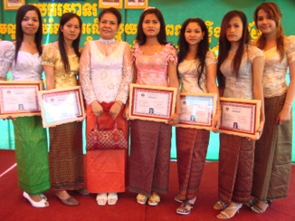
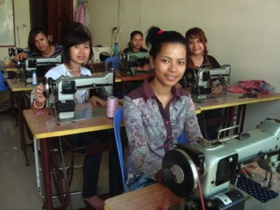
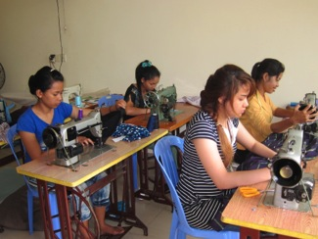
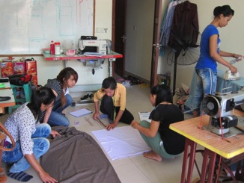
VOCATIONAL TRAINING PROGRAM
The hair dressing training program began in 2007 and the dress making program started in 2008. Both vocational programs provide disadvantaged women the ability to empower themselves with valuable trade skills in which they can use to earn an income.
Each program runs 10 months long and graduates from the program find employment throughout Phnom Penh city, or many go out to open their own shop with the support of PIO and Just World International.
As of now, there have been 28 graduates from the dress making program and 39 graduates from the beauty salon program.
Due to the centre’s renovations, the vocational training program is under temporary hold until the new Centre in the Stung Mean Chey building is ready for operation.

Slide 13
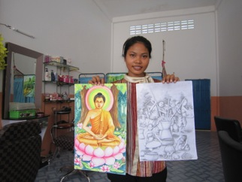
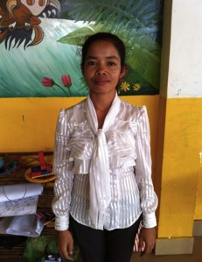
MEET THE YOUNG ADULTS…
My name is Somaly and I am 19 years old.
I live at PIO’s shelter with my three
sisters and one brother. We got here in
2006 to study because our father could
not support us and in early 2008 my
siblings and me were accepted to stay in
the orphanage. First, I went to school at
Stung Mean Chey and then I started the
vocational training program to work in a
beauty saloon. One month ago, I was
selected to start up the beauty saloon next to the Borey Santipheap II school. I am very happy about this responsibility and I am doing my best! My passion is art. I love to paint and thanks to PIO I was able to take classes to learn more and improve. I am currently taking some classes with a local artist and I am very thankful for this. I want to become an art teacher and work with PIO forever! My brothers and I are very lucky to receive PIO’s help. We have the possibility of building a future for ourselves with a smile.
Hello my name is Seth Marady, I am from Pursat
Province but I have been living in Phnom Penh city
for 5 years. I have two children, one five year old
boy and one three year old girl. As young as I can
remember, I have always wanted to learn how to
dress make and create my own clothing designs.
However in the poor village I lived in, there were no
teachers and it wasn’t until I moved to Phnom Penh
that I could finally get the chance to learn. Through
a friend, I was told about the free opportunity to
learn dress making for the underprivileged and I quickly signed up in June 2011. I graduated from the course 6 months later and I am now employed at a clothing store and also at a sewing shop. I am very thankful to PIO and JustWorld International for supporting my education and allowing me to pursue my dream as a dressmaker. I hope to further improve and also hope to return to my village one day and teach the women there how to dress make.

Slide 14
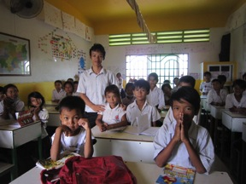
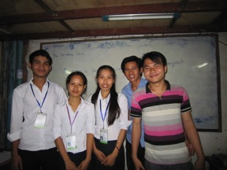
MEET THE STAFF: A QUESTION TO…
Mr. Chan Trea Hun,
Teacher 2nd grade at Stung Mean Chey since 2011
How do you see these children’s future?
They are getting a good education and they are learning many things everyday. I see that they have improved since I first started teaching. They are supplied the right equipment to study, including books, pens, bags, clothes and also food for lunch thanks to JustWorld International. They have the opportunity to create for themselves a better future thanks to education. Many of the children are dedicated students, they are very focused on their studies. Most of them live in extremely poor conditions, but they have the intelligence to understand the importance of education. We also teach them to set goals to themselves and work in order to achieve those goals. PIO school is not only about studying on the books but it is also about teaching these children important skills for their futures.
Mr. Chan Trea Hun and his students
Mr. Seng Pirum (on the right) with the other teachers at the Borei Keila school
Mr. Seng Pirum,
Teacher 3rd grade at Borei Keila since 2010
Could you describe your experience as a teacher working for PIO?
I love teaching and I was already teaching in my homeland, the Kampong Cham province. When I moved to Phnom Penh to find a job and to attend university, a friend told me about PIO. I started teaching at the Stung Mean Chey school and last year I moved to teach at Borei Keila. PIO helps many children and allows them to get an education and go to school, which their poor families cannot afford. Education is very important to me and I want to help as many children as I can. My plan is to continue teaching even after I graduate, possibly at one of PIO’s schools. I believe in our mission and I want to help achieve our goal!

Slide 15
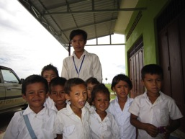
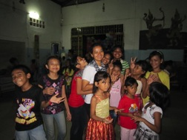
MEET THE STAFF: A QUESTION TO…
Mr. Pol Haingseng,
Teacher 1st grade at Borey Santipheap school
When did you start working for PIO and why?
In 2007 I was forced to move with my family to Borey Santipheap village from a slum area in central Phnom Penh. When we got here there was no local school and PIO was the first organization to open one. I have always wanted to be a teacher and in 2008 I started working for PIO. I like this job and I love the children. PIO is making a difference for these children and I want to be part of it. I see most of the students studying hard and I want to help them have a bright future. We currently have more than 200 students and some of them are part of the vocational training program. I am passionate about our objective and I feel that PIO is concretely improving the quality of life of underprivileged children and their families.
Mr. Pol Haingseng and his students
Mrs. Somaly Yim at the shelter
Mrs. Somaly Yim,
Coordinator of the orphanage and communications officer
How is it to be the “mother” of the children at the shelter?
The first time I visited PIO’s shelter was in 2004. I volunteered for one year to help at the shelter and at the Stung Mean Chey school. In 2010, I was offered a job position at PIO as coordinator of the shelter and I came back with joy. When I started working, it was very hard. The children were all very shy and they wouldn’t talk to me. They knew little about hygiene, politeness and the importance of sharing. After six months, I saw the first improvements. They started to talk and listen to me. I was able to build a respectful relationship based on trust with all of them. Ny, the caretaker, plays a great role in raising these children too. Today, we have 60 children, aged 4 to 18. When visitors come, I can see that they have more self-confidence and know how to behave well. I love all of them and I want to see them succeed in life!

Slide 16
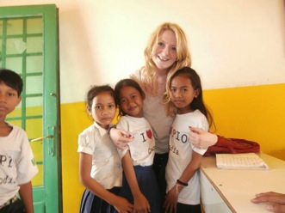
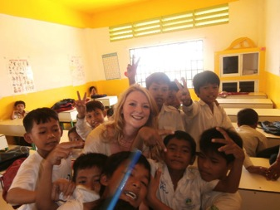
VOLUNTEERING FOR P.I.O.
Kate McFarlane’s experience
“Volunteering with PIO has been a great experience and it is unfortunate that I could only be with them for the short time of three weeks. The school is wonderful; colourful, vibrant and well-equipped, it is a great learning environment to stimulate the children. The kids themselves are lively, polite and inquisitive and I was overwhelmed by the welcome I received and will truly be sad to say goodbye to them.
Teaching grade 2 has been a challenge but always entertaining and the personalities and the energy of the kids make it all worth it. I’ve tried to teach them useful phrases and verbs while working on their listening and reading abilities; using dictation, spelling exercises and filling in the gaps. They definitely enjoy the games the most and I try to play games such as hangman using the vocabulary covered in the lesson or use picture and word cards to engage the class. While their English abilities may be varied, they are all enthusiastic and eager to learn; embracing the challenges that come their way. I will miss them and have really enjoyed getting to know them, playing in the break time and learning Khmer from them!
PIO does an amazing job with these children providing opportunities that they would otherwise be unable to benefit from. The time, money and attention that PIO invests in each child is testament to the bright and successful individuals that they will no doubt become. It has been incredibly rewarding to be part of the organization”.

Slide 17
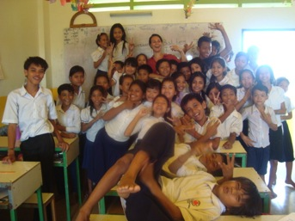
VOLUNTEERING FOR P.I.O.
Ida and Lena’s experience
“We are two Danish girls, Ida and
Lena, who volunteered at the PIO
school in Phnom Penh for four
weeks. We worked as English
teachers in the afternoon and we
each had our own class with about
35 students. Ida was the teacher of
grade 4 and Lena was the teacher of grade 5. We mostly practiced grammar and pronunciation with the students. We were surprised by how much they already knew about English language which made it easier for us to make out a study plan. We also tried to teach them a lot of new words - which they loved!
Some of the best experiences during our volunteering was seeing and
feeling how the kids loved to learn new things, like new words and new
grammar rules. It made it so much better that we were able to see
progress. They were always in a good mood and kept up the good spirit. It was a very hard job being a teacher. We had a lot of students in our classes and teaching them new words was difficult because we obviously don't speak Khmer. But that was also a fun challenge because it forced us as teachers to think out of the box in order for the students to understand what we were trying to each them. So we used a lot of hand gestures and body language to explain different things. And the children seemed to like it and they also remembered what we taught them. At the end of each day we always played some games with the students. Usually it was games related to the themes we had worked with during the afternoon.
All in all, being a teacher at PIO in Cambodia has been a truly
wonderful experience and the smiles of those lovely kids will always be
with us. It was hard and exhausting work but also amazing and so giving”.

Slide 18

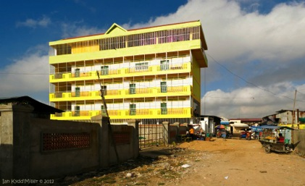
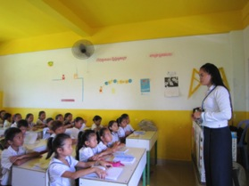
Dear donors,
Thank you all so much for the new building of the Stung Mean Chey school!
My name is Davy Ung and I have been working with PIO since 2006. I am currently the teacher in third and fourth grade.
When I started to teach at PIO, the staff was amazing but the setting was quite limiting. The old school in Stung Mean Chey was small and there were just a few windows. There was always a very bad smell in the classrooms and many flies. It was hot, dark and noisy. We had seven small classrooms, narrow corridors and not enough space for all the children.
The new building instead is amazing! We have nine classes, a big library, a meeting room and a great dining hall on the top floor. The children are very happy about the new building. It is well lit, colorful and spacious. The new building is the perfect setting where the children can be happy and study in a safe environment!
A huge thank you to…
Kathy Hutchinson’s family, the Davidson Family Foundation, Project Hammer (Singapore), Mrs. Qiaoling Di Heil, Mr. Richard Teo, Mrs. Maria Newman, Mr. Tom MacGuinness, Mr. Hiragushi Tomoyuki, Mr. Steve Christov, Lotus Lives, Macquarie, Ingrid and Marc Giesselink.
Your support and kindness is helping PIO to make a difference!
Best wishes,
Davy

Slide 19
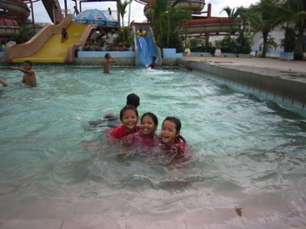
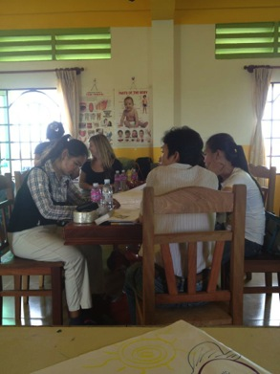
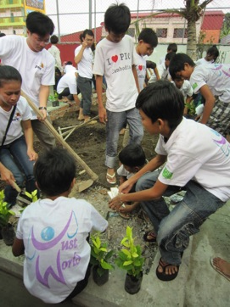
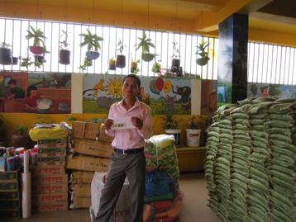
THANK YOU TO ALL OUR SUPPORTERS!
A day at the water park for the children of the orphanage and a workshop for the PIO teachers thanks to Kendra, Katie, Abby and Isabel, teachers at the Canadian International School of Singapore
School material donations and a big help with painting and planting at the playground from
Price Waterhouse Coopers, Ltd.

Slide 20
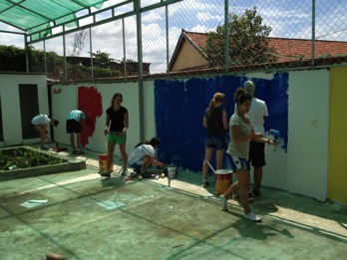



THANK YOU TO ALL OUR SUPPORTERS!
Painting colorful walls at the new playground in Stung Mean Chey with students from the Scopus Memorial College (Australia)
Field trip to the zoo with Qiaoling Di-Heil and her family
Rice distribution to the Stung Mean Chey families supported
by JustWorld International
JustWorld ambassador
Mia Marzotto working on the newsletter with a lot of help
Please consider making a donation today!
Visit us at
www.peopleimprovement.org
www.facebook.com/pio.cambodia

